Slide 1
Algorithms and Data Structures
Lecture V
Simonas Šaltenis
Nykredit Center for Database Research
Aalborg University
simas@cs.auc.dk

Slide 2
This Lecture
Abstract Data Types
  Dynamic Sets, Dictionaries, Stacks, Queues
Linked Lists
Linked Data Structures for Trees

Slide 3
Abstract Data Types (ADTs)
ADT is a mathematically specified entity that defines a set of its instances, with:
  a specific interface – a collection of signatures of operations that can be invoked on an instance,
  a set of axioms (preconditions and postconditions) that define the semantics of the operations (i.e., what the operations do to instances of the ADT, but not how)

Slide 4
Abstract Data Types (ADTs)
  Types of operations:
    Constructors
    Access functions
    Manipulation procedures

Slide 5
Example - Dynamic Sets
We will deal with ADTs, instances of which are sets of some type of elements.
  Operations are provided that change the set
We call such class of ADTs dynamic sets

Slide 6
Dynamic Sets (2)
An example dynamic set ADT
  Methods:
    New():ADT
    Insert(S:ADT, v:element):ADT
    Delete(S:ADT, v:element):ADT
    IsIn(S:ADT, v:element):boolean
  Insert and Delete – manipulation operations
  IsIn – Access method method

Slide 7
Dynamic Sets (3)
Axioms that define the methods:
  IsIn(New(), v) = false
  IsIn(Insert(S, v), v) = true
  IsIn(Insert(S, u), v) = IsIn(S, v), if v ≠ u
  IsIn(Delete(S, v), v) = false
  IsIn(Delete(S, u), v) = IsIn(S, v), if v ≠ u

Slide 8
Priority Queues
A priority queue is an ADT(abstract data type) for maintaining a set S of elements, each with an associated value called key
A PQ supports the following operations
  Insert(S,x) insert element x in set S (S←S∪{x})
  Maximum(S) returns the element of S with the largest key
  Extract-Max(S) returns and removes the element of S with the largest key

Slide 9
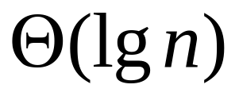
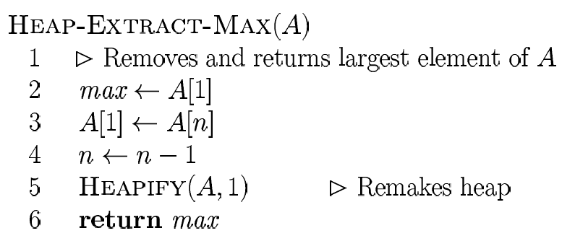
Priority Queues (2)
Removal of max takes constant time on top of Heapify

Slide 10
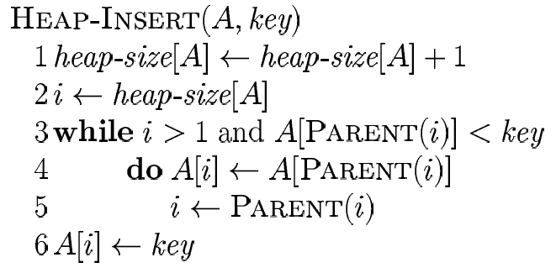
Priority Queues (3)
Insertion of a new element
  enlarge the PQ and propagate the new element from last place ”up” the PQ
  tree is of height lg n, running time:

Slide 11
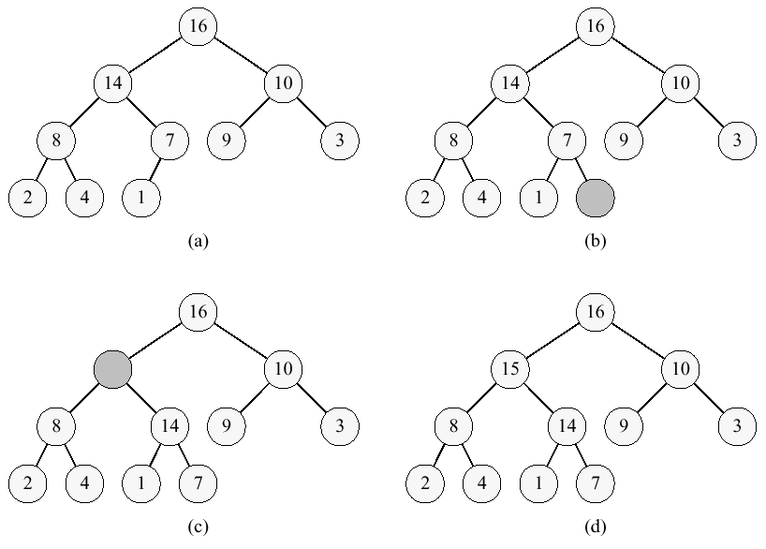
Priority Queues (4)

Slide 12
Priority Queues (5)
Applications:
  job scheduling shared computing resources (Unix)
  Event simulation
  As a building block for other algorithms
A Heap can be used to implement a PQ

Slide 13
Abstract Data Types
Why do we need to talk about ADTs in A&DS course?
  They serve as specifications of requirements for the building blocks of solutions to algorithmic problems
  Provides a language to talk on a higher level of abstraction
  ADTs encapsulate data structures and algorithms that implement them
  Separate the issues of correctness and efficiency

Slide 14
Other Examples
Simple ADTs:
  Queue
  Deque
  Stack

Slide 15
Stacks
A stack is a container of objects that are inserted and removed according to the last-in-first-out (LIFO) principle.
Objects can be inserted at any time, but only the last (the most-recently inserted) object can be removed.
Inserting an item is known as “pushing” onto the stack. “Popping” off the stack is synonymous with removing an item.

Slide 16
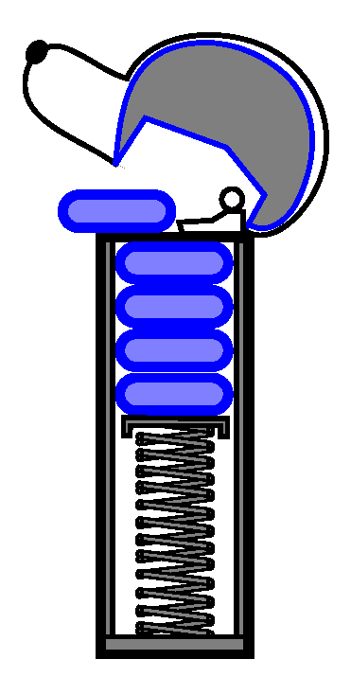
Stacks (2)
A PEZ ® dispenser as an analogy:

Slide 17
Stacks(3)
A stack is an ADT that supports three main methods:
  new():ADT – Creates a new stack
  push(S:ADT, o:element):ADT - Inserts object o onto top of stack S
  pop(S:ADT):ADT - Removes the top object of stack S; if the stack is empty an error occurs
  top(S:ADT):element – Returns the top object of the stack, without removing it; if the stack is empty an error occurs

Slide 18
Stacks(4)
The following support methods could also be defined:
  size(S:ADT):integer - Returns the number of objects in stack S
  isEmpty(S:ADT): boolean - Indicates if stack S is empty
Axioms
  Pop(Push(S, v)) = S
  Top(Push(S, v)) = v

Slide 19

An Array Implementation
Create a stack using an array by specifying a maximum size N for our stack.
The stack consists of an N-element array S and an integer variable t, the index of the top element in array S.
Array indices start at 0, so we initialize t to -1

Slide 20
An Array Implementation (2)
Pseudo code
Algorithm push(o)
if size()==N then
return Error
t=t+1
S[t]=o
Algorithm pop()
if isEmpty() then
return Error
S[t]=null
t=t-1
Algorithm size()
return t+1
Algorithm isEmpty()
return (t<0)
Algorithm top()
if isEmpty() then
return Error
return S[t]

Slide 21
An Array Implementation (3)
The array implementation is simple and efficient (methods performed in O(1)).
There is an upper bound, N, on the size of the stack. The arbitrary value N may be too small for a given application, or a waste of memory.

Slide 22
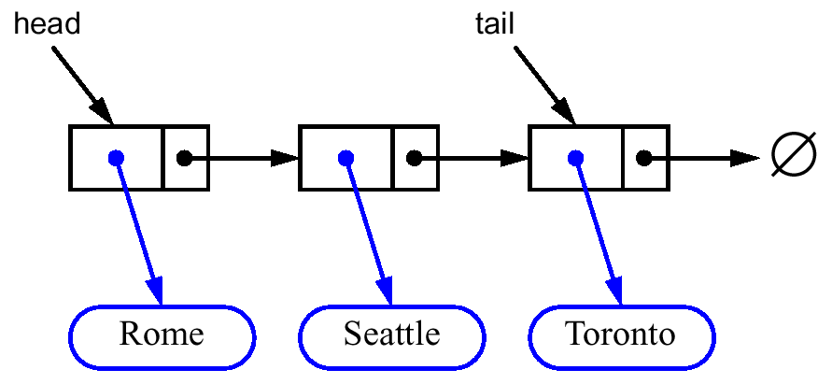
Singly Linked List
Nodes (data, pointer) connected in a chain by links
the head or the tail of the list could serve as the top of the stack

Slide 23
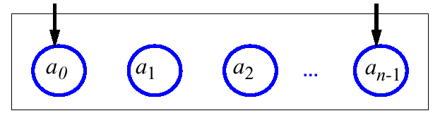
Queues
A queue differs from a stack in that its insertion and removal routines follows the first-in-first-out (FIFO) principle.
Elements may be inserted at any time, but only the element which has been in the queue the longest may be removed.
Elements are inserted at the rear (enqueued) and removed from the front (dequeued)
Front
Rear
Queue

Slide 24
Queues (2)
The queue supports three fundamental methods:
  New():ADT – Creates an empty queue
  Enqueue(S:ADT, o:element):ADT - Inserts object o at the rear of the queue
  Dequeue(S:ADT):ADT - Removes the object from the front of the queue; an error occurs if the queue is empty
  Front(S:ADT):element - Returns, but does not remove, the front element; an error occurs if the queue is empty

Slide 25
Queues (3)
These support methods should also be defined:
  Size(S:ADT):integer
  IsEmpty(S:ADT):boolean
Axioms:
  Front(Enqueue(New(), v)) = v
  Dequeque(Enqueue(New(), v)) = New()
  Front(Enqueue(Enqueue(Q, w), v)) = Front(Enqueue(Q, w))
  Dequeue(Enqueue(Enqueue(Q, w), v)) = Enqueue(Dequeue(Enqueue(Q, w)), v)

Slide 26
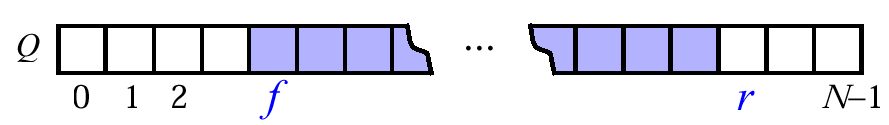
An Array Implementation
Create a queue using an array in a circular fashion
A maximum size N is specified.
The queue consists of an N-element array Q and two integer variables:
  f, index of the front element (head – for dequeue)
  r, index of the element after the rear one (tail – for enqueue)

Slide 27
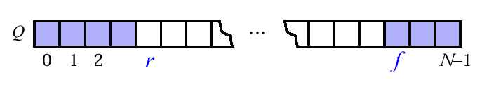
An Array Implementation (2)
“wrapped around” configuration
what does f=r mean?

Slide 28
An Array Implementation (3)
Pseudo code
Algorithm dequeue()
if isEmpty() then
return Error
Q[f]=null
f=(f+1)modN
Algorithm enqueue(o)
if size = N - 1 then
return Error
Q[r]=o
r=(r +1)modN
Algorithm size()
return (N-f+r) mod N
Algorithm isEmpty()
return (f=r)
Algorithm front()
if isEmpty() then
return Error
return Q[f]

Slide 29
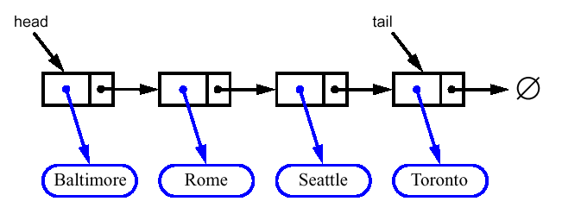
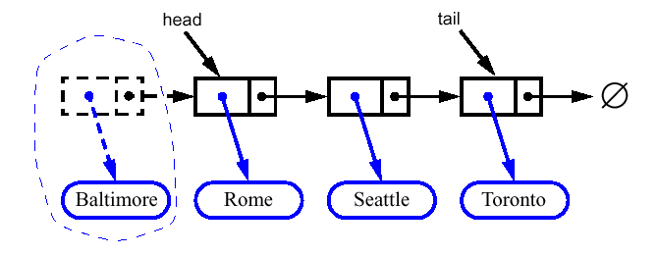
Linked List Implementation
Dequeue - advance head reference

Slide 30
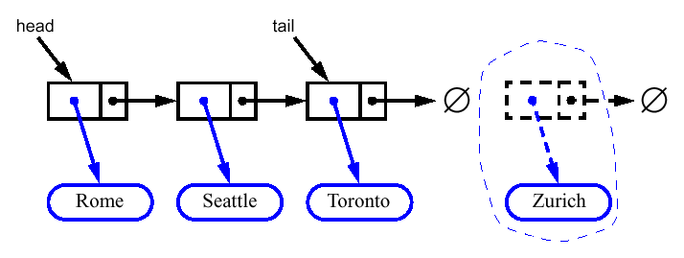
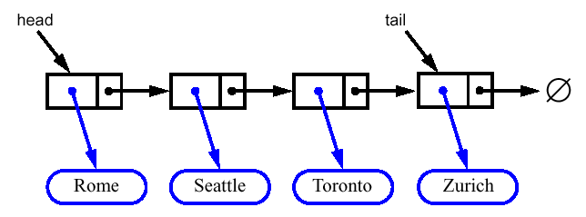
Linked List Implementation (2)
Enqueue - create a new node at the tail
chain it and move the tail reference

Slide 31
Double-Ended Queue
A double-ended queue, or deque, supports insertion and deletion from the front and back
The deque supports six fundamental methods
  InsertFirst(S:ADT, o:element):ADT - Inserts e at the beginning of deque
  InsertLast(S:ADT, o:element):ADT - Inserts e at end of deque
  RemoveFirst(S:ADT):ADT – Removes the first element
  RemoveLast(S:ADT):ADT – Removes the last element
  First(S:ADT):element and Last(S:ADT):element – Returns the first and the last elements

Slide 32
Stacks with Deques
Implementing ADTs using implementations of other ADTs as building blocks
Stack Method | Deque Implementation
size() | size()
isEmpty() | isEmpty()
top() | last()
push(o) | insertLast(o)
pop() | removeLast()

Slide 33
Queues with Deques
Queue Method | Deque Implementation
size() | size()
isEmpty() | isEmpty()
front() | first()
enqueue(o) | insertLast(o)
dequeue() | removeFirst()

Slide 34
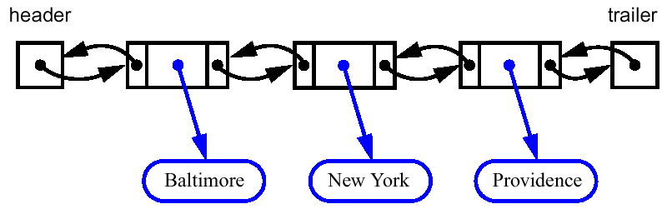
Doubly Linked Lists
Deletions at the tail of a singly linked list cannot be done in constant time
To implement a deque, we use a doubly linked list
A node of a doubly linked list has a next and a prev link
Then, all the methods of a deque have a constant (that is, O(1)) running time.

Slide 35
Doubly Linked Lists (2)
When implementing a doubly linked lists, we add two special nodes to the ends of the lists: the header and trailer nodes
  The header node goes before the first list element. It has a valid next link but a null prev link.
  The trailer node goes after the last element. It has a valid prev reference but a null next reference.
The header and trailer nodes are sentinel or “dummy” nodes because they do not store elements

Slide 36
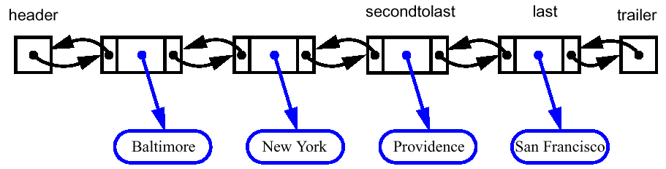
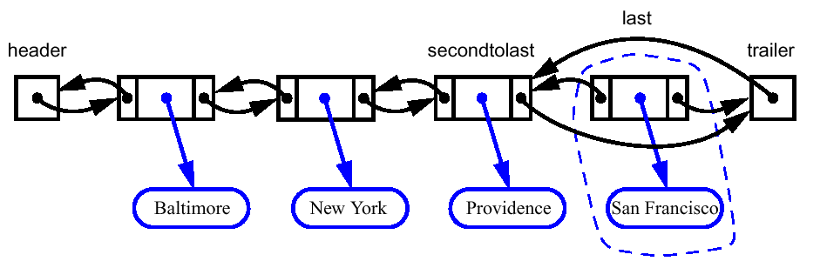
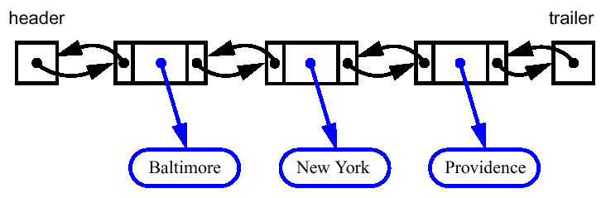

Slide 37
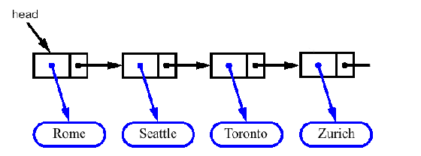
Circular Lists
No end and no beginning of the list, only one pointer as an entry point
Circular doubly linked list with a sentinel is an elegant implementation of a stack or a queue

Slide 38
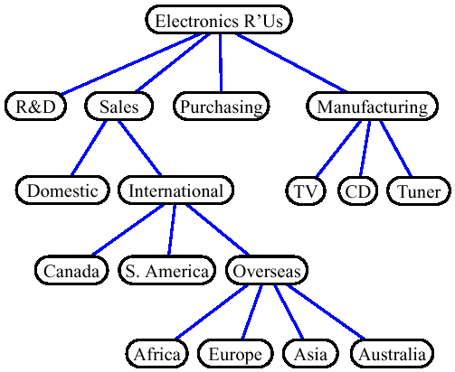
Trees
A rooted tree is a connected, acyclic, undirected graph

Slide 39
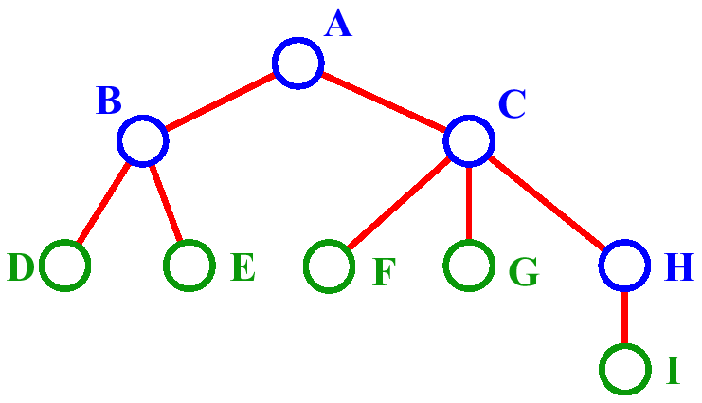
Trees: Definitions
A is the root node.
B is the parent of D and E. A is ancestor of D and E. D and E are descendants of A.
C is the sibling of B
D and E are the children of B.
D, E, F, G, I are leaves.

Slide 40
Trees: Definitions (2)
A, B, C, H are internal nodes
The depth (level) of E is 2
The height of the tree is 3
The degree of node B is 2

Slide 41
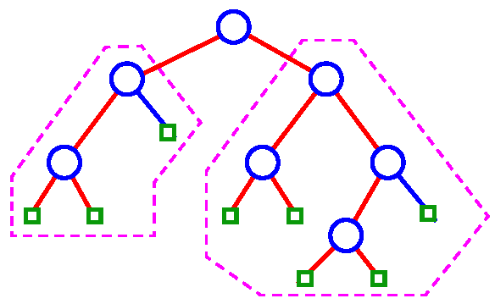
Binary Tree
Binary tree: ordered tree with all internal nodes of degree 2

Slide 42
Representing Rooted Trees
BinaryTree:
  Parent: BinaryTree
  LeftChild: BinaryTree
  RightChild: BinaryTree
Root
∅
∅
∅
∅
∅
∅
∅
∅
∅
∅
∅

Slide 43
Unbounded Branching
UnboundedTree:
  Parent: UnboundedTree
  LeftChild: UnboundedTree
  RightSibling: UnboundedTree
Root
∅
∅
∅
∅
∅
∅
∅
∅
∅
∅
∅

Slide 44
Next Week
Hashing

